Slide 1
STH 32
Village & Town of Somers
Project ID: 3240-00-03/73
STH 32 | Alford Park Dr. to 21st ST. | RESURFACING PROJECT
Kenosha/Racine Counties
September 9, 2021

Slide 2
Agenda
Project Limits
Alternatives
Purpose and need
  Bike Accommodation Connectivity
  Crash history
  Road diet benefits
Operational Analysis - Define LOS A-F
Speed Study
  Results
  Further discussions with Central Office
Environmental Process
  Neighborhood plan
  Public Informational meeting
Project Schedule

Slide 3
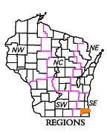

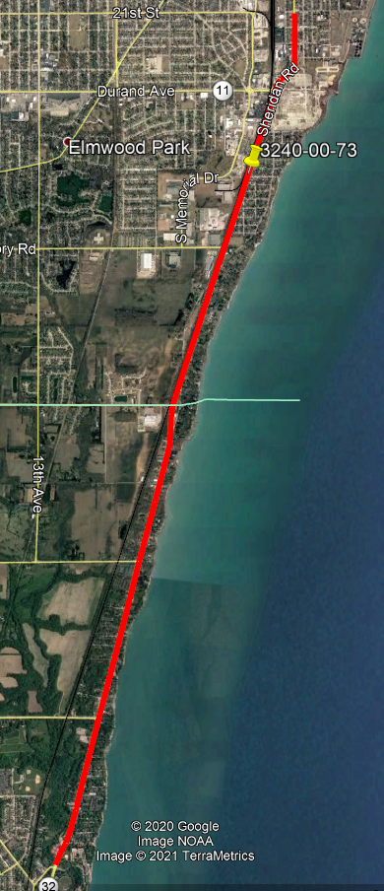
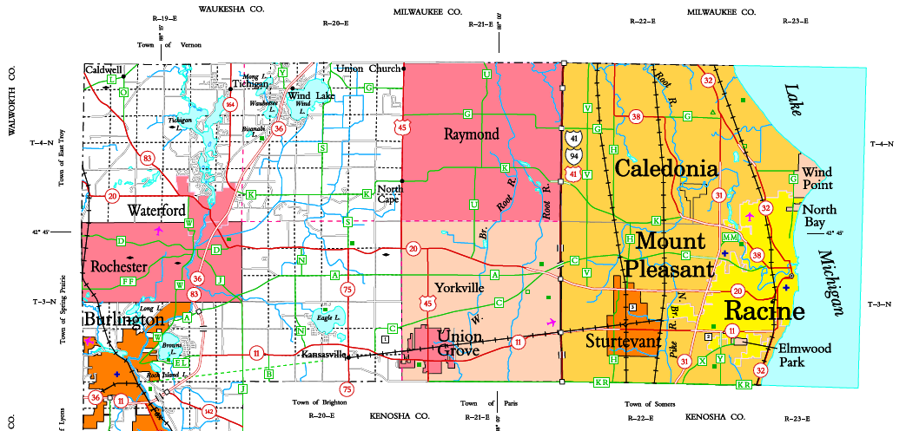
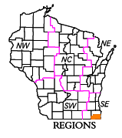
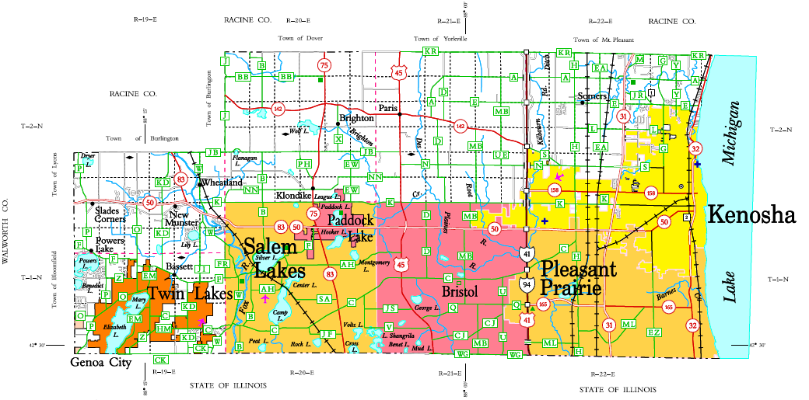
STH 32 Project Limits: Alford Park Ave. to 21st St.
Racine County
Kenosha County

Slide 4
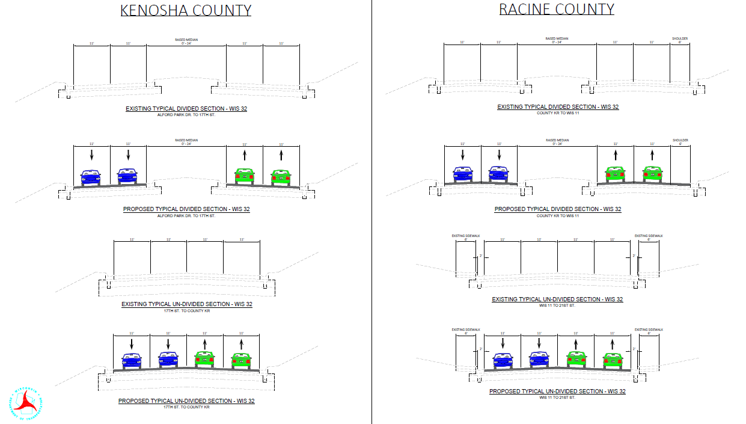
Alternative 1: Replace in Kind
Notes:
Alford Park Dr to 17th Street – City of Kenosha
17th Street to County KR – Village of Somers
County KR to WIS 11 – Village of Mount Pleasant
WIS 11 to 21st Street – City of Racine

Slide 5
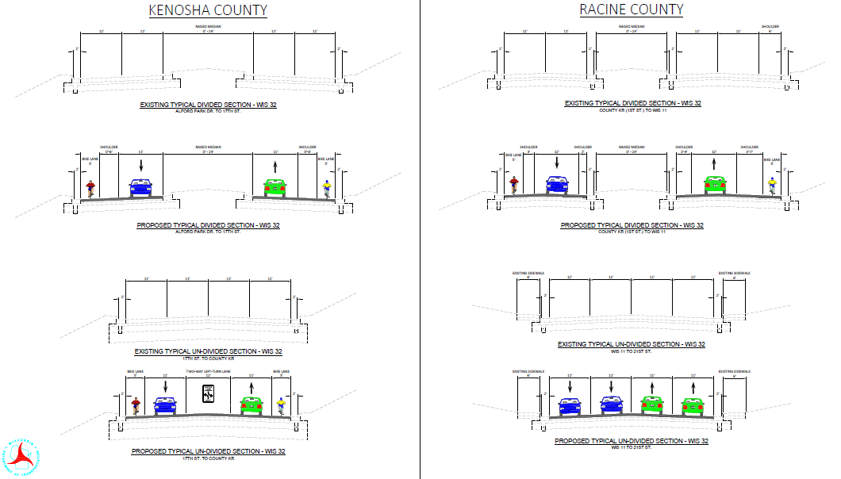
Alternative 2: Two-Way Left Turn Lane

Slide 6
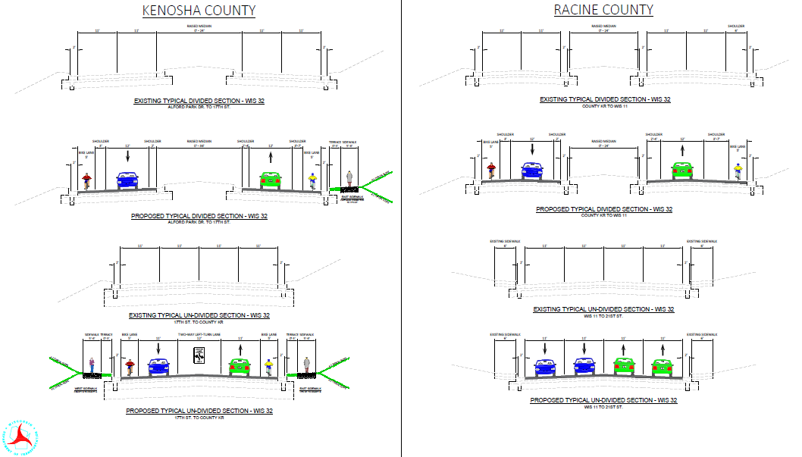
Alternative 3: Two-Way Left Turn Lane w/ Sidewalks

Slide 7
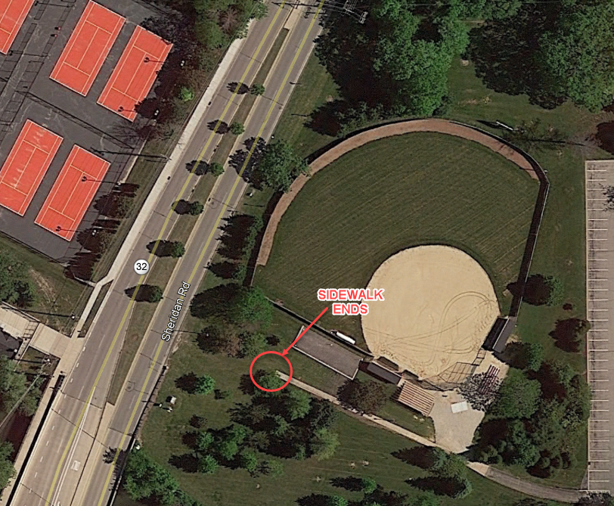
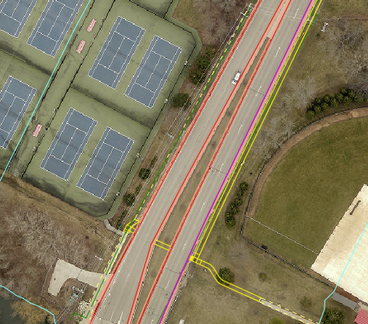
Pedestrian Accommodations
  Existing: Sidewalk ends short of STH 32 with worn area at crossing
  Proposed: Pedestrian crossing at STH 32 to get access to west side and Smeds Tennis Center

Slide 8
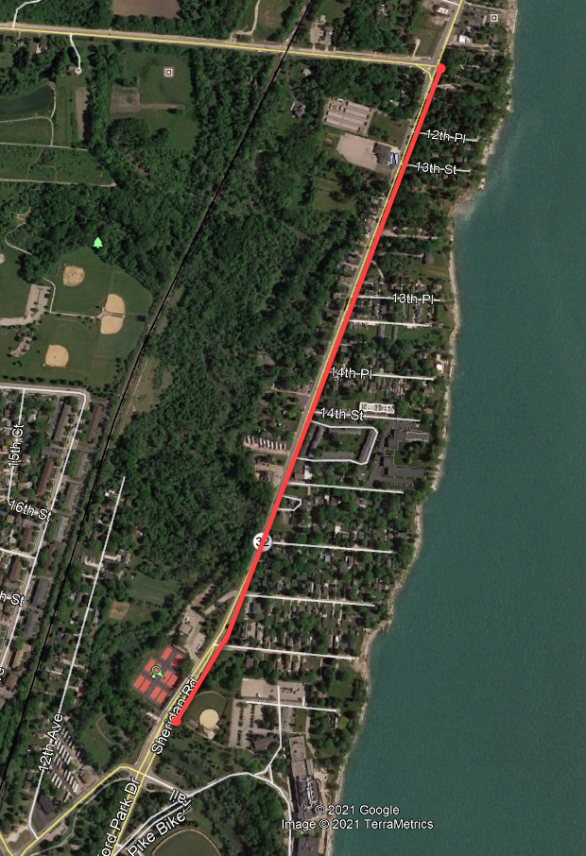
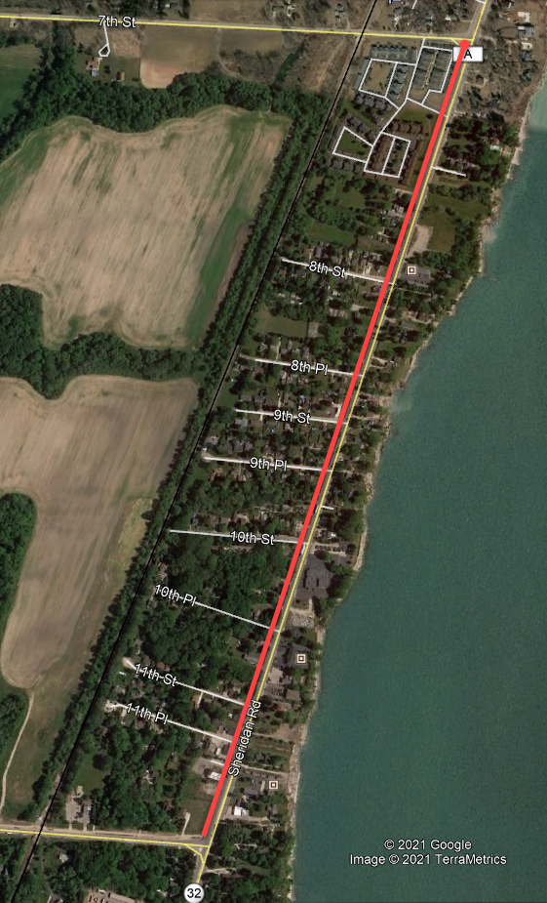
Pedestrian Accommodations
  Proposed: Construct sidewalk on the east side of STH 32 from Carthage College north to CTH E (12th Ave.)
  Proposed: Construct sidewalk on the west side of STH 32 from CTH E (12th Ave.) north to CTH A
  Sidewalk Addition
  80% state, 20% local funding
  Construction outside existing roadway between Alford Park Drive and CTH A only

Slide 9
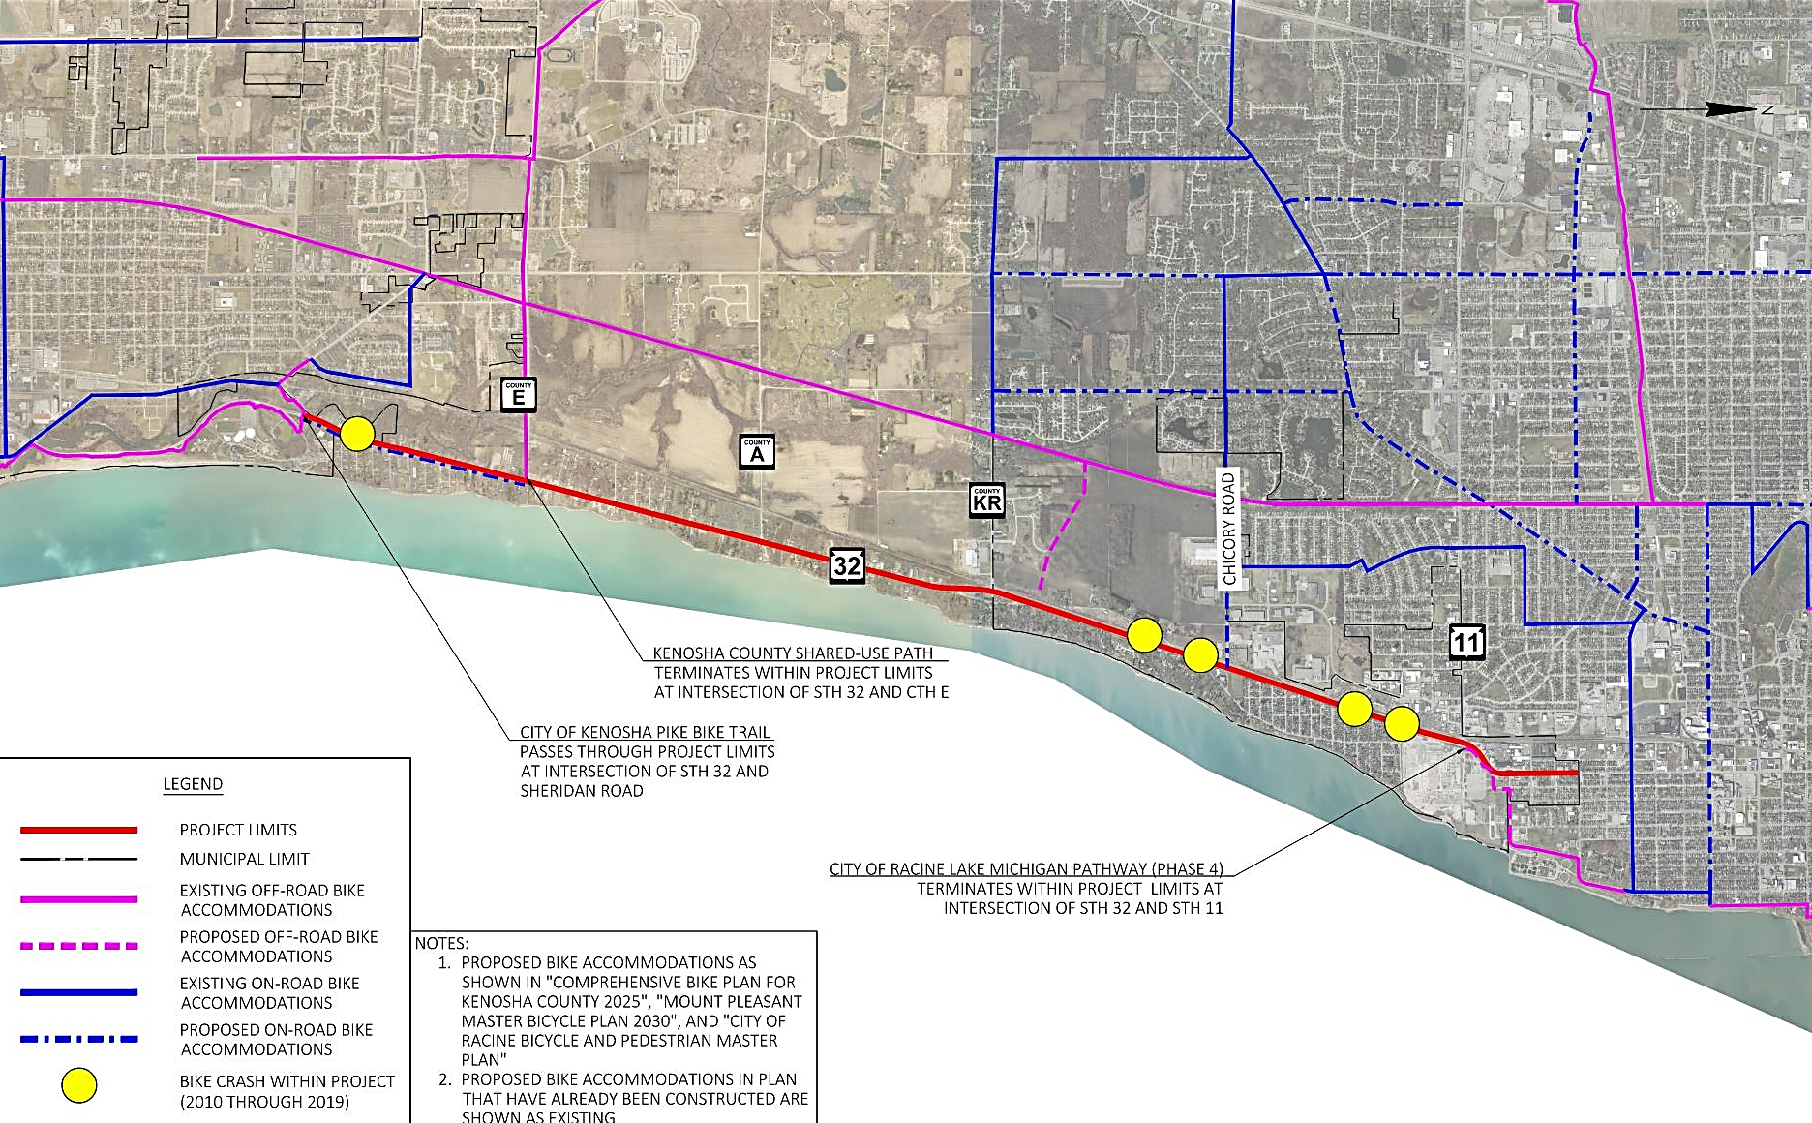
STH 32 – Bike Accommodation Connectivity
Notes:
Pink = off-road
Blue = on-road
Solid = existing
Dashed = proposed

Slide 10
Left Turning Angle & Rear End Crashes
  13 crashes involving vehicles making left hand turns
  Mostly sporadic, but a small concentration at the Somers House Tavern
Notes:
TWLTL will help reduce these types of crashes

Slide 11
Bicycle & Pedestrian Crashes
Notes:
Pedestrian Crashes: Xing – K, K, K, B Along – C, A, K, C
Fatals Peds – south of 7th, north of 12th, north of Chickory, Smeds Tennis.
IN 2020 THERE WAS ALSO A PED CRASH AT 16TH PLACE AND A BIKE CRASH BETWEEN 10TH PLACE/10TH STREET THAT POLICE REPORTS NOT AVAILABLE FOR YET!!! BOTH INJURY SEVERITY B
LINK TO MAP: https://transportal.cee.wisc.edu/partners/community-maps/crash/search/BasicSearch.do

Slide 12
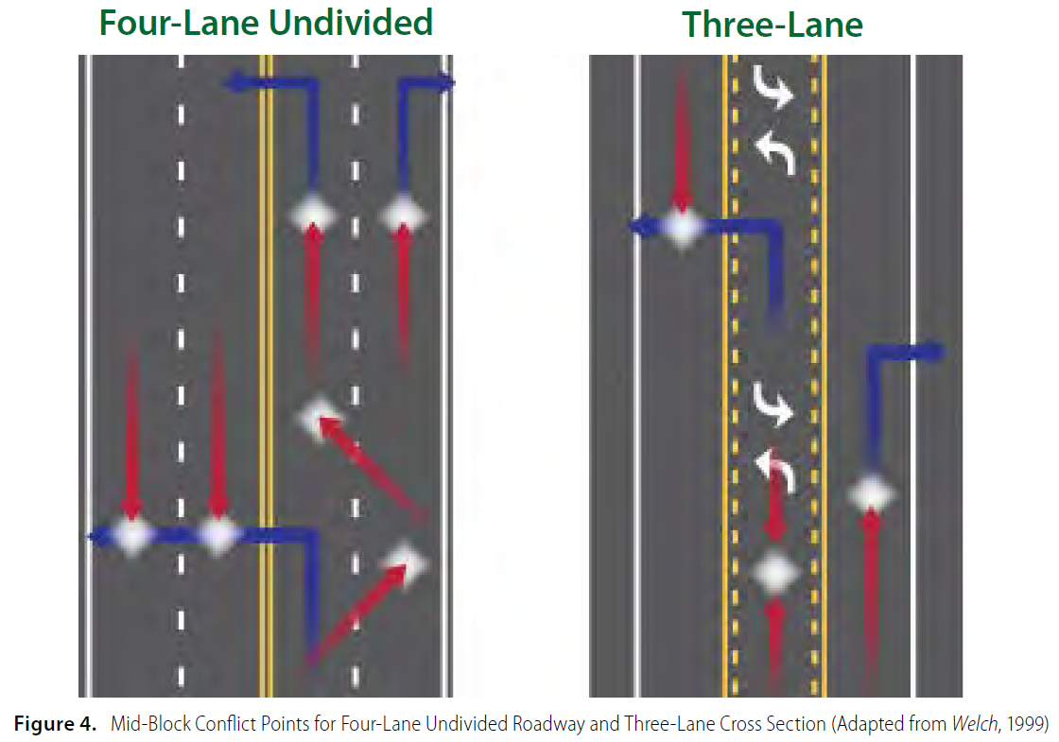
Road Diet Benefits
  Protected left turn lane for mid-block left turning vehicles
    Simplifies gap selection for motorists (especially older and younger drivers) making left turns
  Reduces crossing distance for pedestrians
  Reduces travel speeds which leads to decreased crash severity
  Reduces crash rate (overall crash reduction of 19% to 47%) through reduction of conflict points both mid-block and at intersections
    Reduction of rear-end and left-turn crashes through TWLTL
    Reduction of right-angle crashes through reduction of number of lanes side street motorists need to cross
    Reduction of sideswipe crashes due to elimination of need to change lanes
    Reduction of bike/ped crashes due to fewer lanes to cross, protected space to wait while crossing or turning
Notes:
Eliminates speed variations which causes sideswipes.

Slide 13
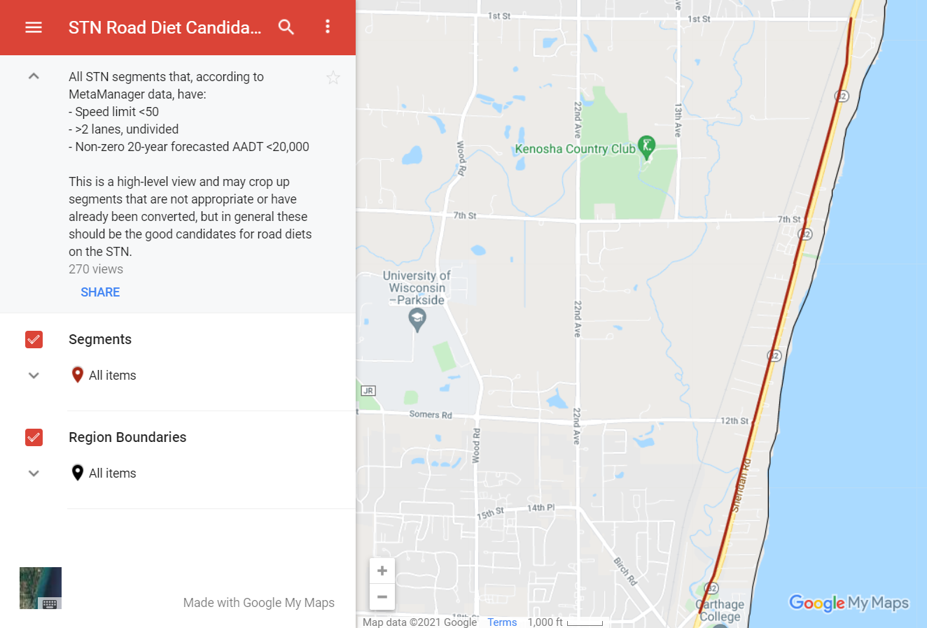
Road Diets
STH 32 between Alford Park Dr and CTH KR is on WisDOT’s statewide road diet candidate map
Notes:
There is a statewide road diet candidate map that included the section of STH 32 in Racine County.

Slide 14
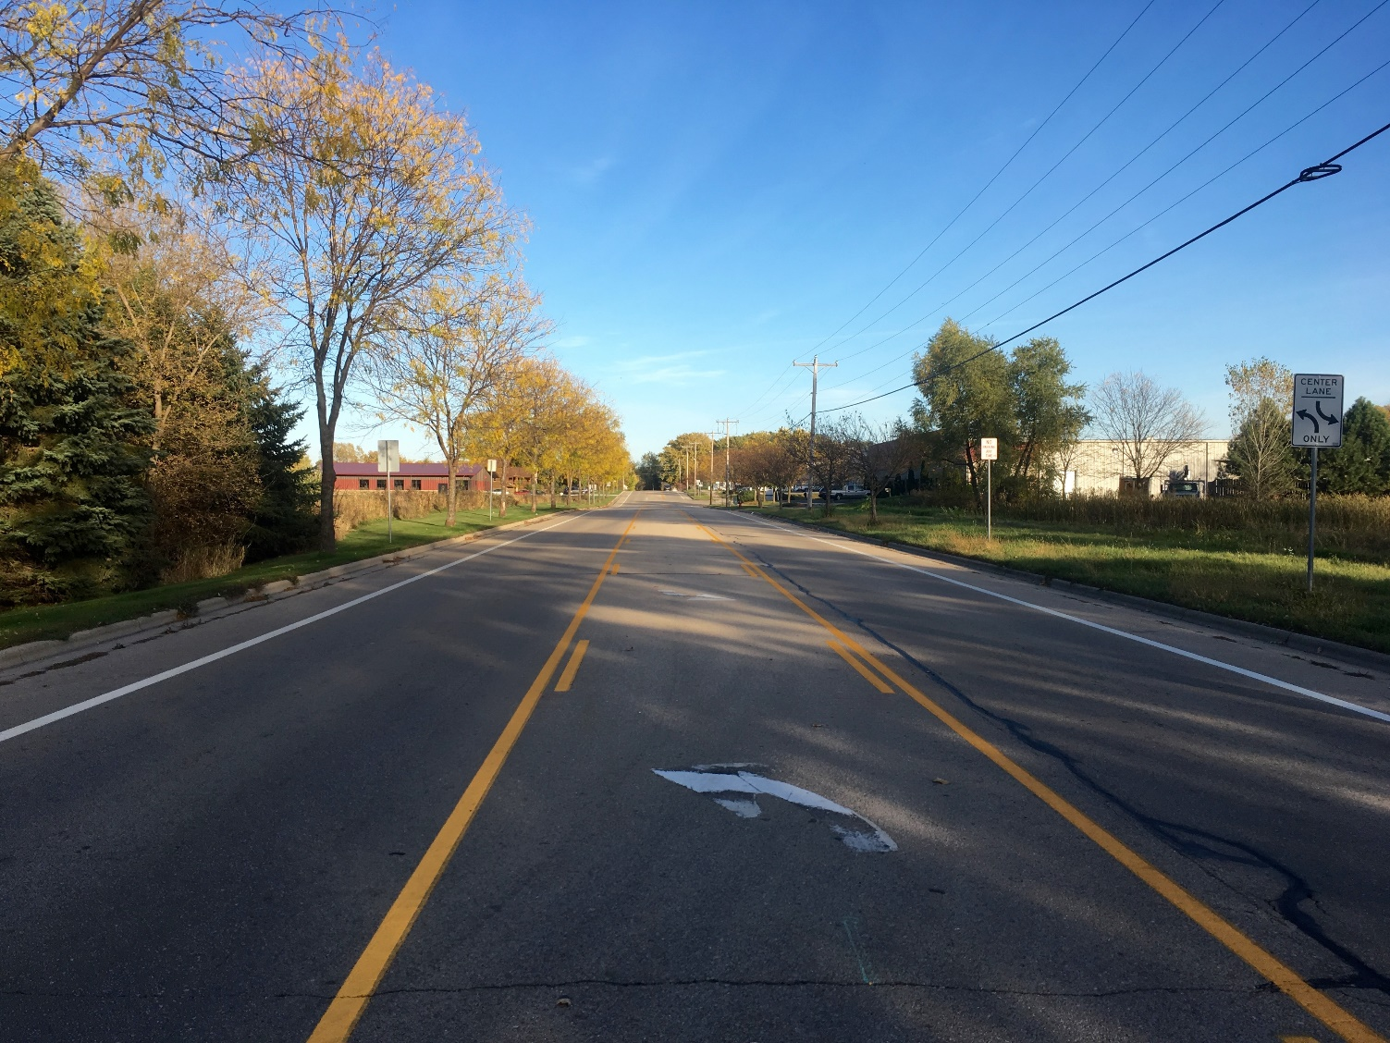
Road Diets
Voges Road – near Madison
Notes:
Same 44 feet between curbs as STH 32.

Slide 15
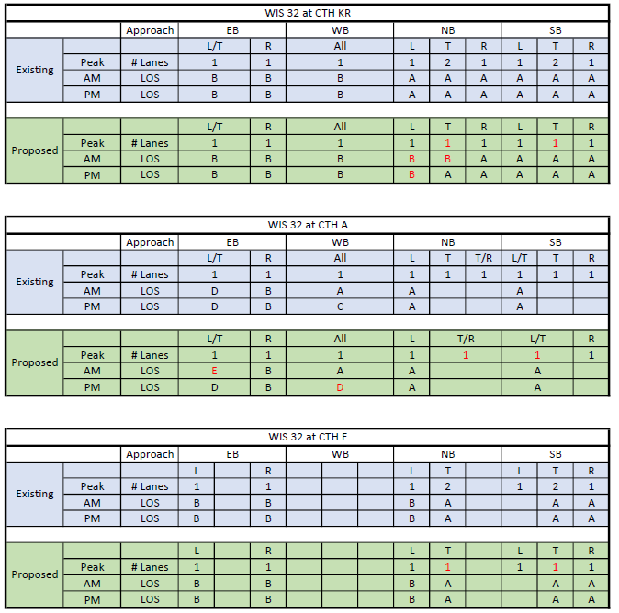
Operational Analysis
All movements at the signalized intersections (CTH KR and CTH E) are expected to operate at LOS B or better.
The EB left/through movement at CTH A showed a LOS E during the AM peak period. The delay is 37.5 seconds (existing is 26 sec) and the queue length is 25 feet. This would be considered acceptable.
Notes:
Traffic:
S of 7th – 9,100-11,900
N of 7th – 11,500-13,000
T% - 4.9-11.4%

Slide 16
Operational Analysis
Level of Service Definition – the ratio of traffic volume to roadway capacity
LOS A – Represents free-flow conditions.
LOS B – Allows speeds at or near free-flow speeds, but the presence of other users begins to be noticeable.
LOS C – Has speeds at or near free-flow speeds, but the freedom to maneuver is noticeably restricted (lane changes require careful attention on the part of drivers).
LOS D – Represents the conditions where speed begins to decline slightly with increasing flow. The freedom to maneuver become more restricted and drivers experience reductions in in physical and psychological comfort.
LOS E – Represents operating conditions at or near the roadway’s capacity.
LOS F – Describes a breakdown in vehicular flow.

Slide 17
Speed Study – Kenosha County
 | Northbound
 | Location | Average Speed | 50th Percentile | 85th Percentile | Pace Speed Range | Max Speed | Time
 | 0.35 miles S of Countyline Road | 47.6 | 47 | 52 | 44.0 to 53.0 | 67 | 9:00 AM 7/14/2021
 | 400' N of 8th St | 45.5 | 46 | 50 | 41.0 to 50.0 | 57 | 10:00 AM 7/14/2021
 | 150' S of 17th St | 43.2 | 43 | 48 | 38.0 to 47.0 | 56 | 11:00 AM 7/14/2021
 | Southbound
 |  | Average Speed | 50th Percentile | 85th Percentile | Pace Speed Range | Max Speed | Time
 | 0.35 miles S of Countyline Road | 46.7 | 47 | 52 | 42.0 to 51.0 | 58 | 9:30 AM 7/14/2021
 | 400' N of 8th St | 46 | 46 | 50 | 42.0 to 51.0 | 62 | 10:30 AM 7/14/2021
 | 150' S of 17th St | 42.9 | 43 | 47 | 38.0 to 47.0 | 58 | 11:30 AM 7/14/2021
Allowed to reduce the speed limit:
5 mph below 85th percentile speed
Not more than 2 mph below the 50th percentile speed.
Additional speed reduction requires Central Office approval.

Slide 18
Speed Study – Racine County
 | Northbound
 | Location | Average Speed | 50th Percentile | 85th Percentile | Pace Speed Range | Max Speed | Time
 | Richard Avenue | 49.3 | 48 | 55 | 43.0 to 52.0 | 80 | 10:45 AM 7/21/2021
 | Edgewater Drive | 48.7 | 48 | 53 | 44.0 to 53.0 | 73 | 9:15 AM 7/20/2021
 | Southbound
 |  | Average Speed | 50th Percentile | 85th Percentile | Pace Speed Range | Max Speed | Time
 | Richard Avenue | 48.8 | 48 | 54 | 43.0 to 52.0 | 69 | 11:00 AM 7/20/2021
 | Edgewater Drive | 48.1 | 48 | 53 | 43.0 to 52.0 | 67 | 10:00 AM 7/20/2021
Allowed to reduce the speed limit:
5 mph below 85th percentile speed
Not more than 2 mph below the 50th percentile speed.
Additional speed reduction requires Central Office approval.

Slide 19

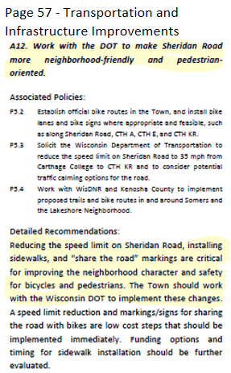
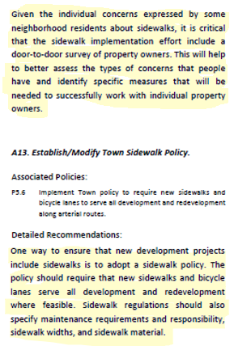
Environmental Process
Numerous references to bicycle and pedestrian accommodations throughout the report.

Slide 20
Environmental Process
Public Involvement Meeting
As part of the National Environmental Policy Act (NEPA), WisDOT uses a public involvement meeting (PIM) to disseminate information and to give the public an opportunity to voice their viewpoint about a particular plan, project, or alternative.
WisDOT will hold a PIM in the fall of 2021 to gather public comment prior to finalizing the scope of the project.

Slide 21
Full Project Schedule
OPM – Completed February 2021
LOM– May 20, 2021
PIM – September 2021
Final Scoping Plan Meeting – November 2021
Environmental Document – May 2022
60% Meeting – July 2022
DSR – August 2022
Final Plat – January 2023
DT 1078 Plan – June 2023
PS&E – August 2024
LET – December 2024

Slide 22
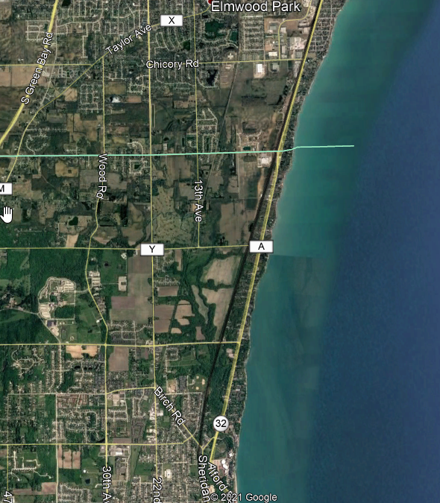

Thank-You! Are there any Questions/comments?

